Slide 1

Capstone Design (2)
11th week : Life Sports Total Solution
Date | 2019.05.13
Presenter | 공찬형
Team | 공찬형, 금강현, 이동현

Slide 2
Index
Feedback
Implementation
Schedule
Q & A

Slide 3
Feedback

Slide 4
1. Feedback
Why Hadoop?
Memory growth expense is exponential
The analysis process inhibits the original module performance
Goal: After periodic analysis via Hadoop, data is stored in the RDB

Slide 5
1. Feedback
Why Spring & React-native?
Choosing Spring and react-native is purely for learning purposes.
Nevertheless, I think it is advantageous to reuse the Controller or Service code written in Spring in React.

Slide 6
Implementation

Slide 7
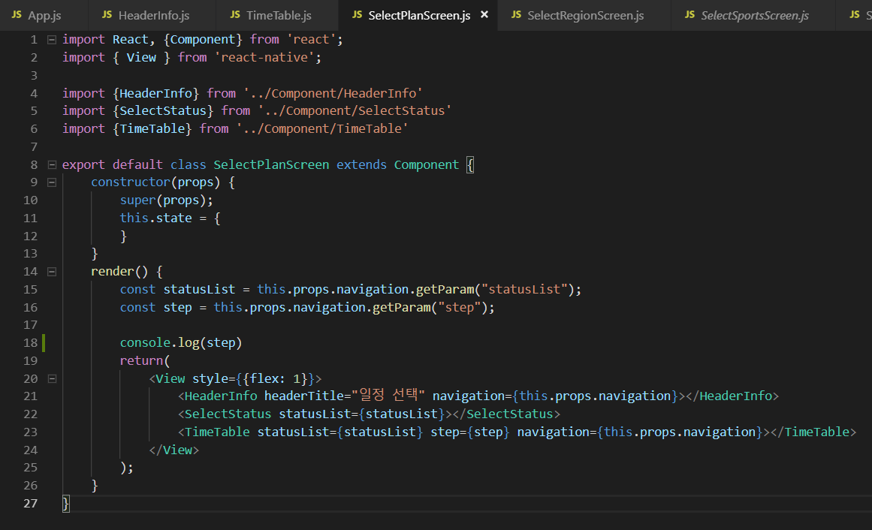
2. Implementation
React-native
Reused Components
Predefined tags
Easy to make each screen

Slide 8
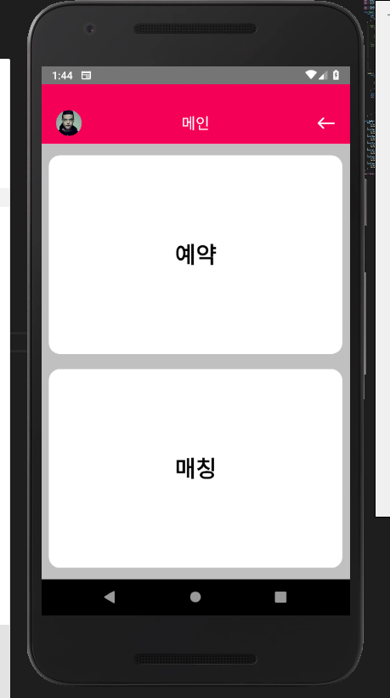
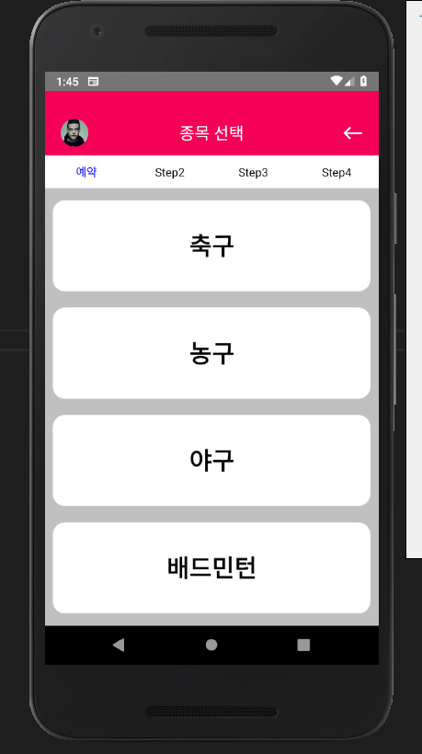
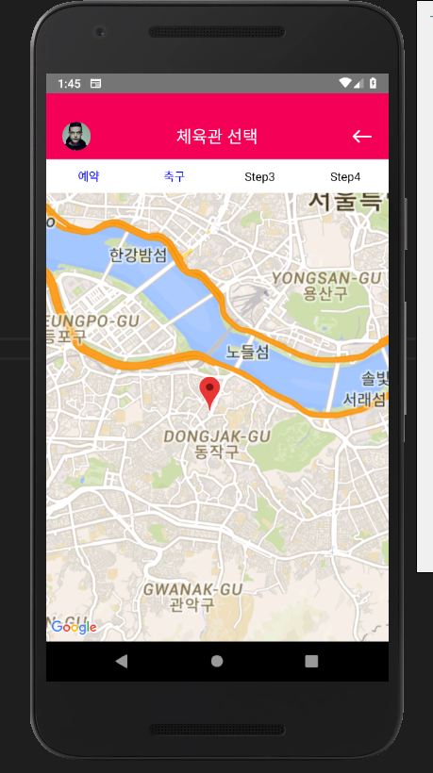
2. Implementation
1. Select Menu
2. Select Sports
3. Select Region

Slide 9
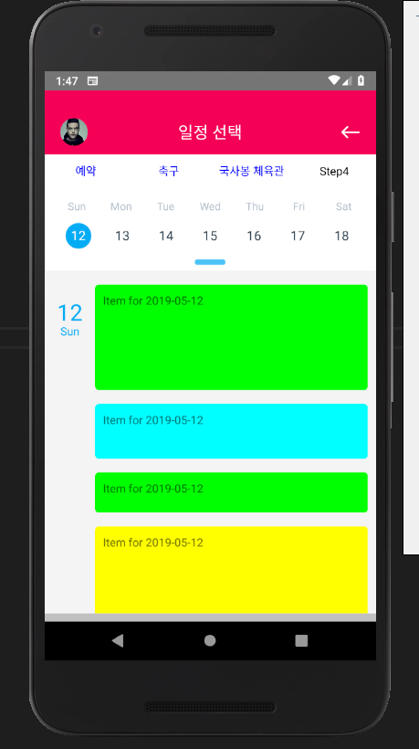
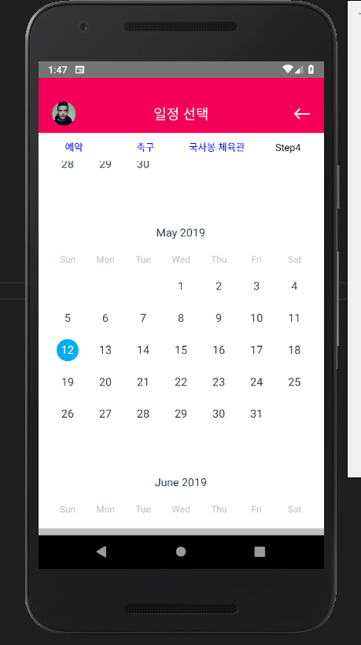
2. Implementation
React-native-calander
Used to select dates

Slide 10
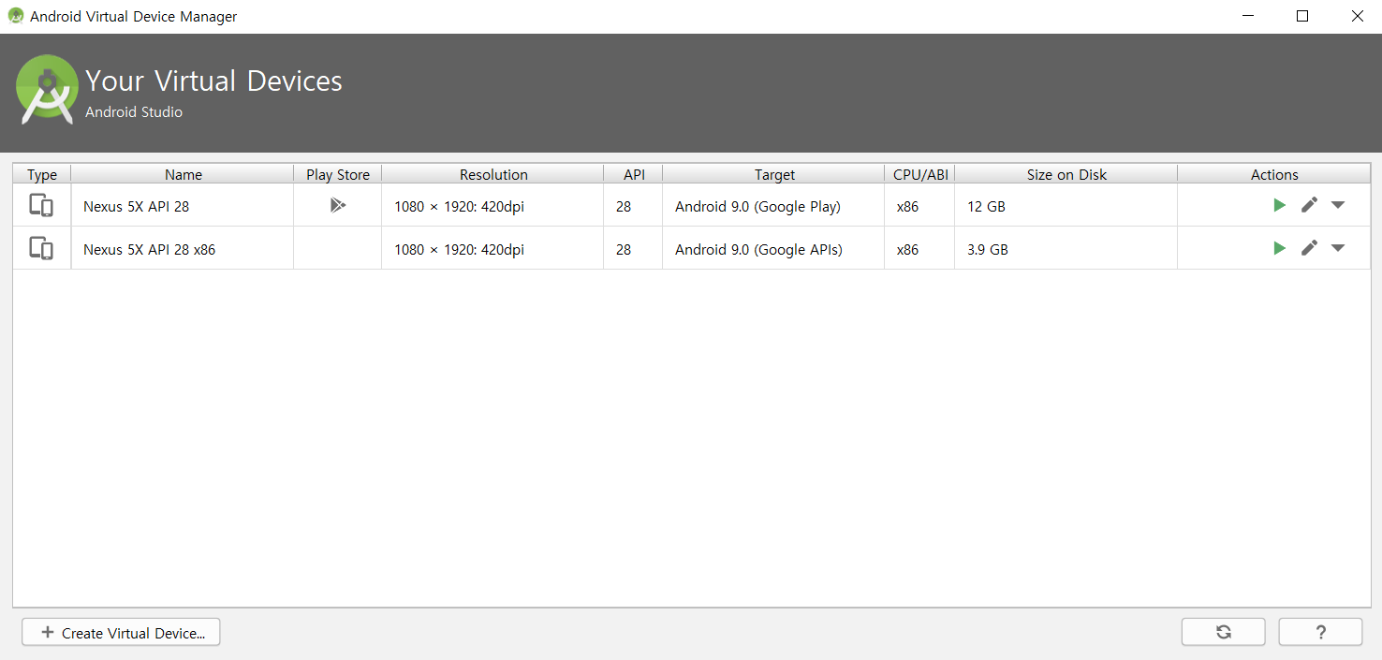
2. Implementation - Troubleshooting
<React-native-maps Problem>
- React native maps do not work properly on virtual machines where the Play Store is not supported.

Slide 11
3. Implementation : DB Data Generation
27 tables data have been generated
Soccer matches will be used for data analysis and recommendation
사용자 | User
사용자별관심종목 | pref_subj_per_user
사용자별 업적 | badge_per_user
축구전적 | soccer_record
야구전적 | baseball_record
농구전적 | basketball_record
배드민턴전적 | badminton_record
사용자별선호체육관 | pref_gym_per_user
사용자별선호체육시설 | pref_fac_per_user
팀 | team
팀별 업적 | badges_per_team
팀별선호체육관 | pref_gym_per_team
팀별선호체육시설 | pref_fac_per_team
팀별팀원목록 | team_user_list
경기결과 | match_result
경기참여자명단 | match_participant
예약경기 | reserv_matches
오픈매칭 | open_match
체육관 관리자 | gym_admin
체육관 | gym
시설정보 | fac_info
종목 | subject
업적 | badge
시설 일정 | fac_schedule
토너먼트 게시판 | tournament_board
토너먼트 | Tournament
토너먼트 일정 | tournament_schedule

Slide 12
3. Implementation : DB Data Generation
Every gym in Seoul (207 gyms) has been registered
# of Facilites : Soccer(1~2), Basketball(1~2), Baseball(1), Badminton(2~8)
Based on facility details in Seoul gym information site (서울시 정보 공개 포탈)
Randomly generate schedules for each facility based on probability
Specific teams have regular matches on specific gyms
About 30,000 matches are generated (4/1 ~ 5/18)
About 5,000 users, 140 teams have been generated
Gym
User
Facility
Team
Reserv Match
Open Match
Tournament
Match Result

Slide 13








3. Implementation : Hadoop Cluster
Recommendation Function is implemented with Hadoop eco-system
Data import /export : Sqoop
Periodically import / export data from RDB for data analysis to use recommendation
Analyze and process data using Hive, Impala and Spark
Use Kafka to asynchronize data import and data export
Use Oozie for scheduling
Periodically perform the whole process and save the result on RDB
Scheduling
Batch Data
Asynchronous
HDFS
Import
Export
Streaming Data

Slide 14
Schedule

Slide 15
4. Personal Project Schedule
Lee, Donghyun : DB Construction & Data Analysis, Recommendation Implementation
Dates | March |  |  |  | April |  |  |  |  | May |  |  |  | June
Task Descriptions | 4 | 11 | 18 | 25 | 1 | 8 | 15 | 22 | 29 | 6 | 13 | 20 | 27 | 3 | 10 | 17
Team Organization |  |  |  |  |  |  | Midterm Demonstration & Presentation |  |  |  |  |  |  | Final Demonstration & Presentation
Subject Confirmation / Write out the Proposal
Data collection & Generation / Data modeling
Database Construction
Hadoop Installation / CDH Cluster Construction
Data Analysis using Hadoop Cluster
Test and Debugging
Preparing for Final Demo
Writing Manuals and Reports

Slide 16
4. Personal Project Schedule
Gong, Chanhyung : Web Structure construction, Web & app implementation
Dates | March |  |  |  | April |  |  |  |  | May |  |  |  | June
Task Descriptions | 4 | 11 | 18 | 25 | 1 | 8 | 15 | 22 | 29 | 6 | 13 | 20 | 27 | 3 | 10 | 17
Team Organization |  |  |  |  |  |  | Midterm Demonstration & Presentation |  |  |  |  |  |  | Final Demonstration & Presentation
Subject Confirmation / Write out the Proposal
Web UI Design
Web Structure Construction
Functional Implementation : Manager Web Site
Functional Implementation : Matching Service (App)
Functional Implementation : Ranking System (App)
Test and Debugging
Preparing for Final Demo
Writing Manuals and Reports

Slide 17
4. Personal Project Schedule
Geum, Kanghyeon : App Structure construction, Web & App implementation
Dates | March |  |  |  | April |  |  |  |  | May |  |  |  | June
Task Descriptions | 4 | 11 | 18 | 25 | 1 | 8 | 15 | 22 | 29 | 6 | 13 | 20 | 27 | 3 | 10 | 17
Team Organization |  |  |  |  |  |  | Midterm Demonstration & Presentation |  |  |  |  |  |  | Final Demonstration & Presentation
Subject Confirmation / Write out the Proposal
App UI Design
App Structure Construction
Functional Implementation : Manager Web Site
Functional Implementation : Reservation (App)
Functional Implementation : Matching Service (App)
Functional Implementation : Ranking System (App)
Test and Debugging
Preparing for Final Demo
Writing Manuals and Reports

Slide 18
2. Project Schedule
Dates Task Descriptions | March |  |  |  | April |  |  |  |  | May |  |  |  | June
 | 4 | 11 | 18 | 25 | 1 | 8 | 15 | 22 | 29 | 6 | 13 | 20 | 27 | 3 | 10 | 17
Team Organization |  |  |  |  |  |  | Midterm Demonstration & Presentation |  |  |  |  |  |  | Final Demonstration & Presentation
Subject Confirmation / Write out the Proposal
Web UI Design
Web Structure Construction
Data collection & Generation / Data modeling
Database Construction
App UI Design
App Structure Construction
Functional Implementation : Manager Web Site
Functional Implementation : Reservation (App)
Hadoop Installation / CDH Cluster Construction
Data Analysis using Hadoop Cluster
Functional Implementation : Matching Service (App)
Functional Implementation : Ranking System (App)
Test and Debugging
Preparing for Final Demo
Writing Manuals and Reports

Slide 19
Q&A

